Slide 1
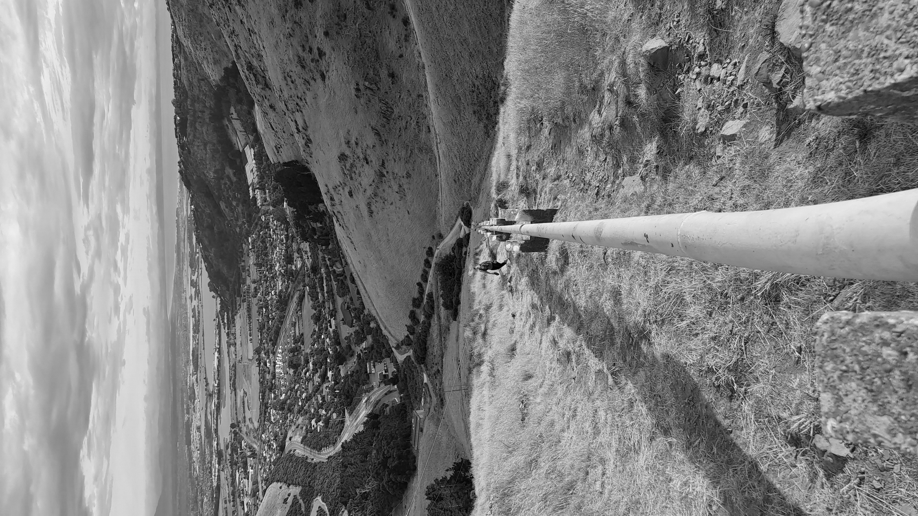
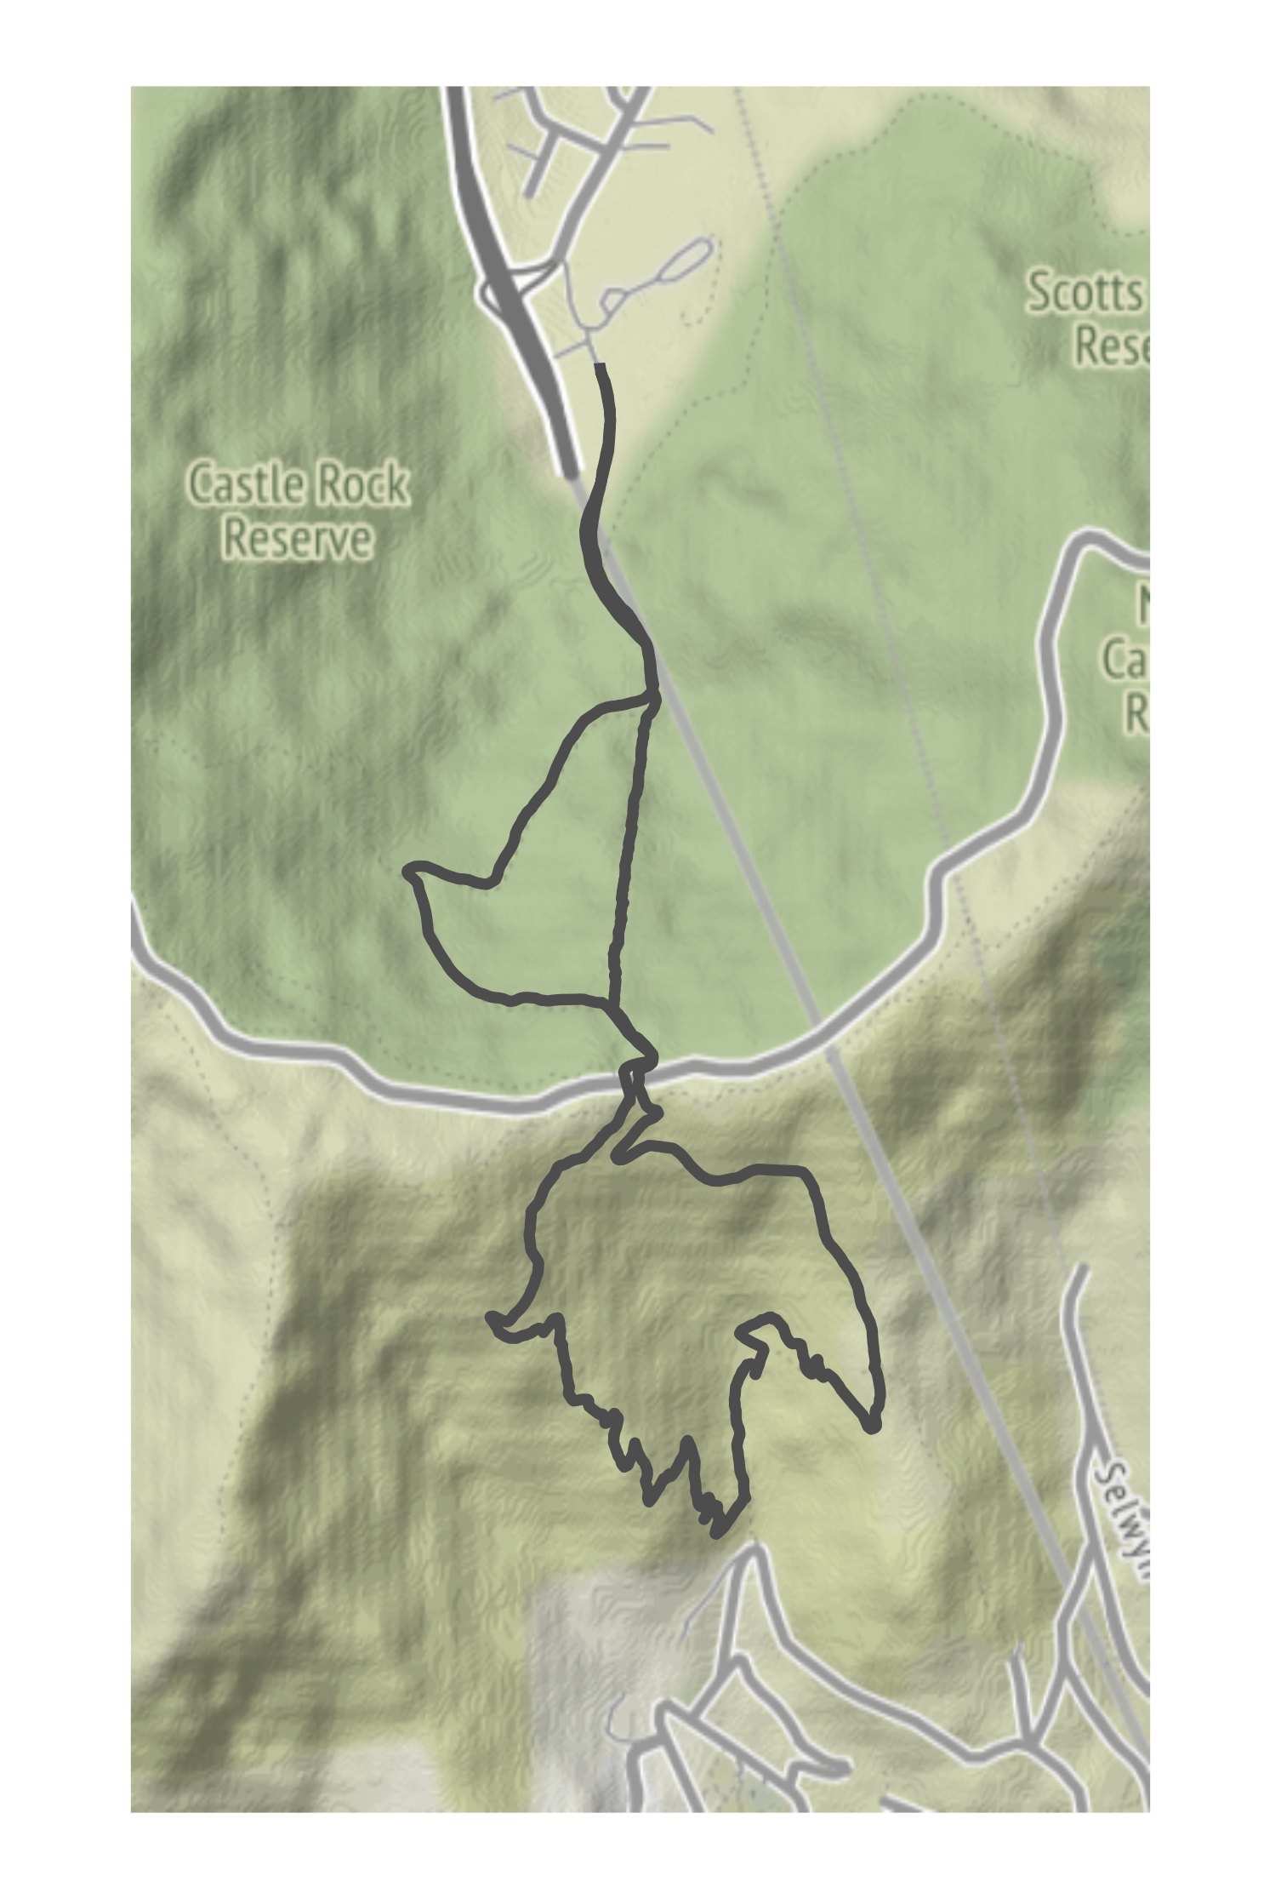
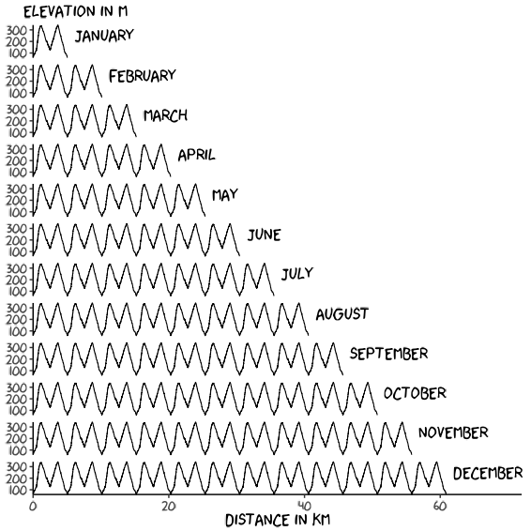
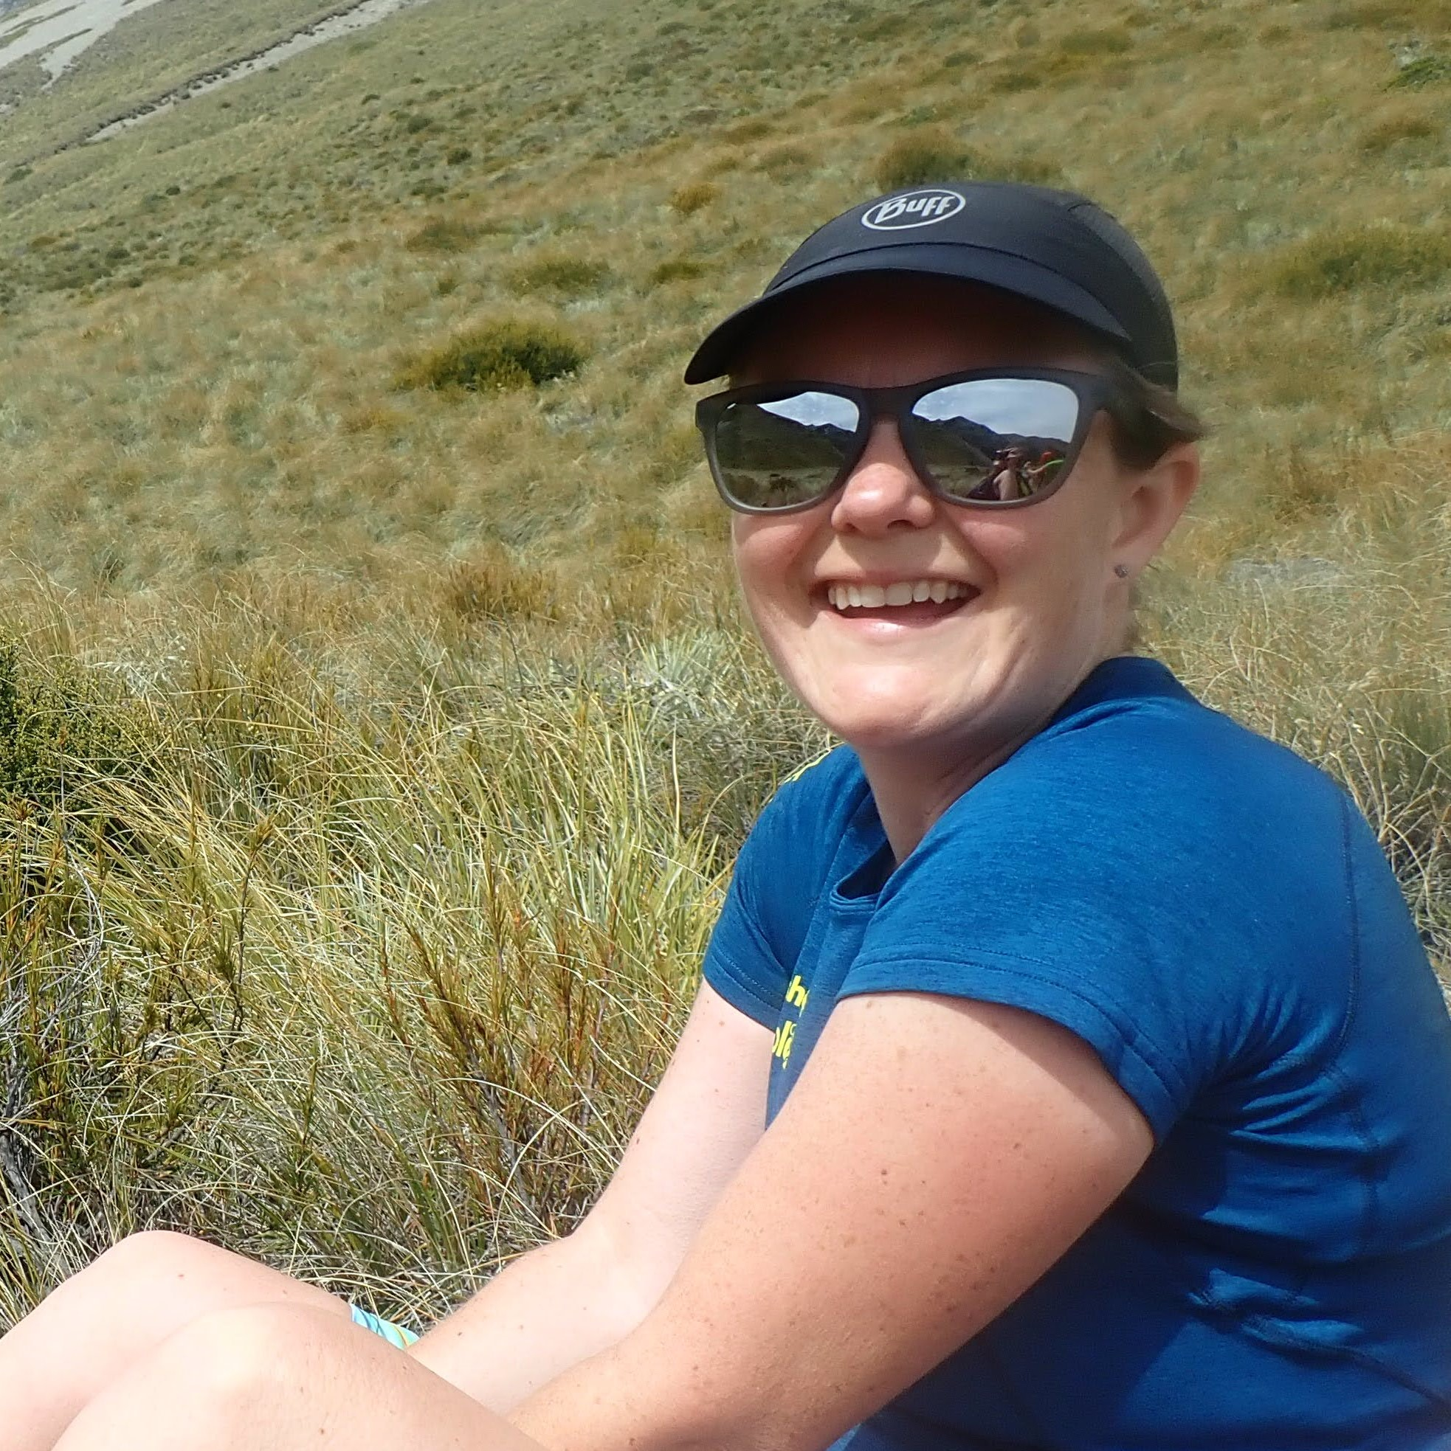

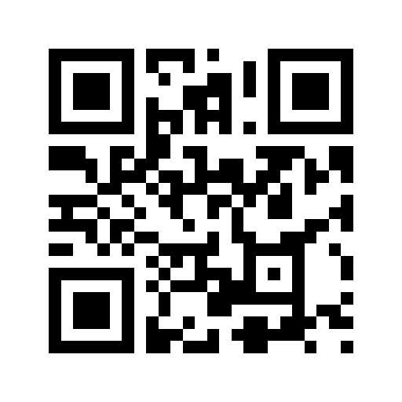


Adventure for Dementia
I’m taking on an adventurous running challenge to raise awareness of dementia in New Zealand and support Dementia Canterbury.
The route
Today’s laps
One lap = 5 km &
480 m climbing
Cheer me on if you see
me out on the trail!
Donate here
Follow the journey
@amy_goes_adventuring
@adventurefordementia.nz

Slide 2
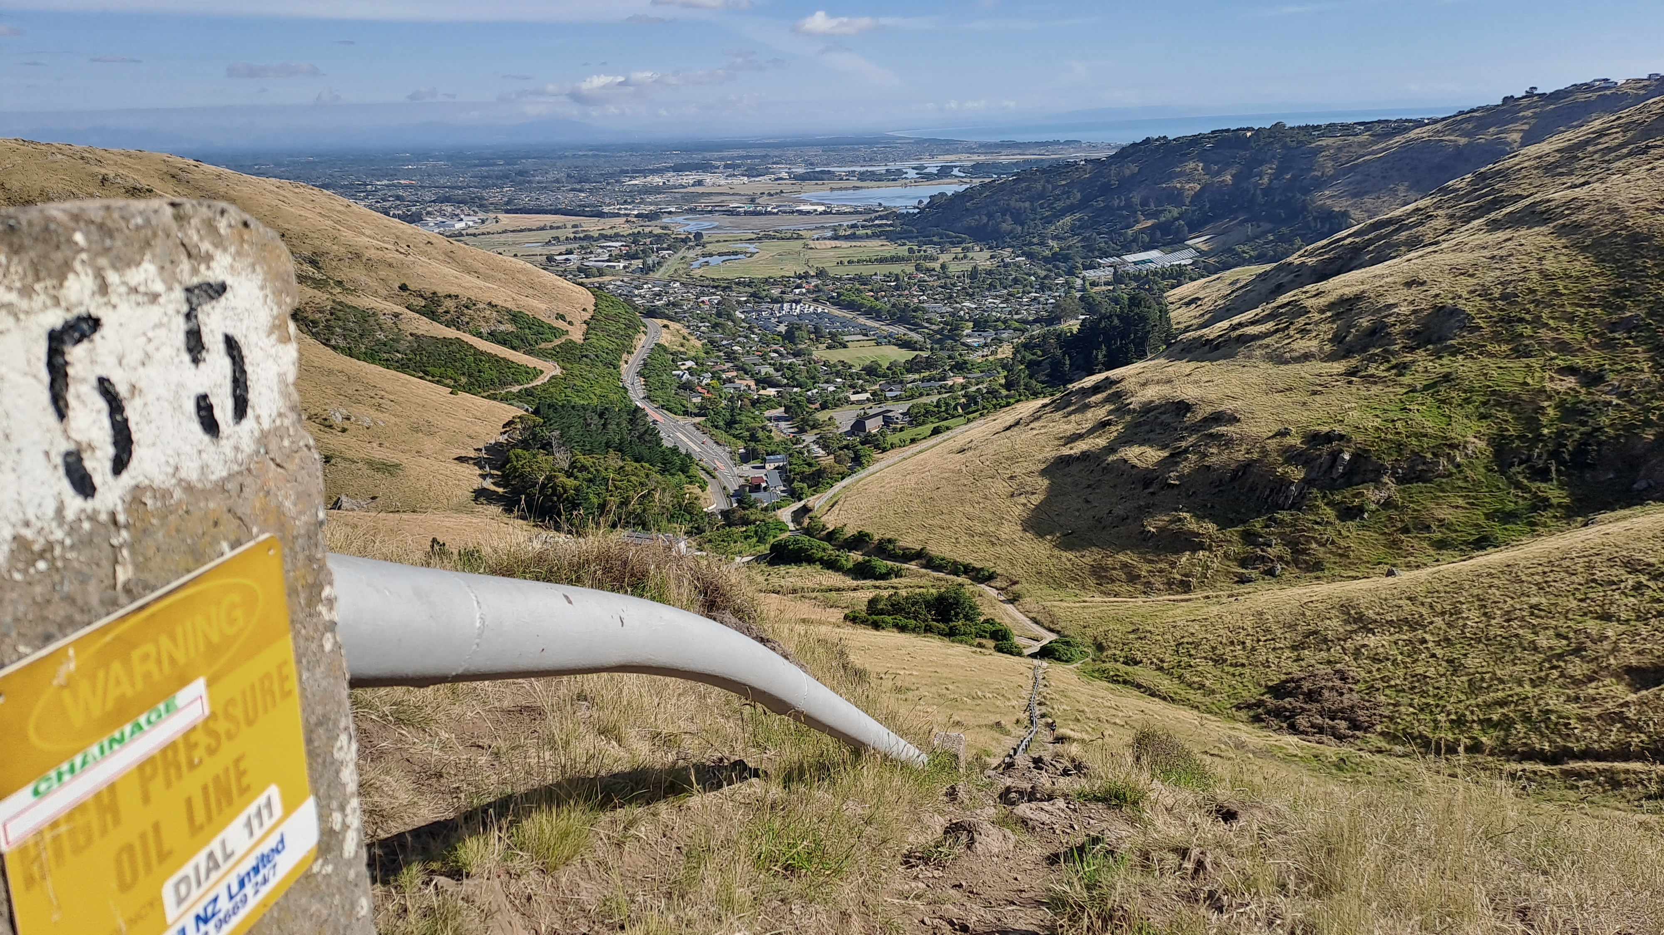
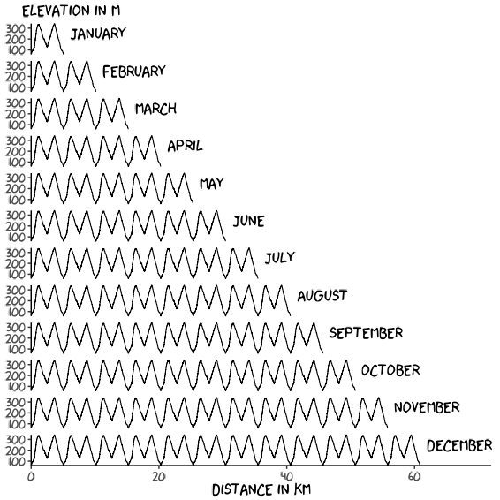
Adventure for Dementia
I’m embarking on an adventurous running challenge in 2023 to raise awareness of dementia in New Zealand and to raise funds for Dementia Canterbury who offer support for families affected by dementia.
Today’s laps
Social Media
@amy_goes_adventuring
@adventurefordementia.nz

